Slide 1
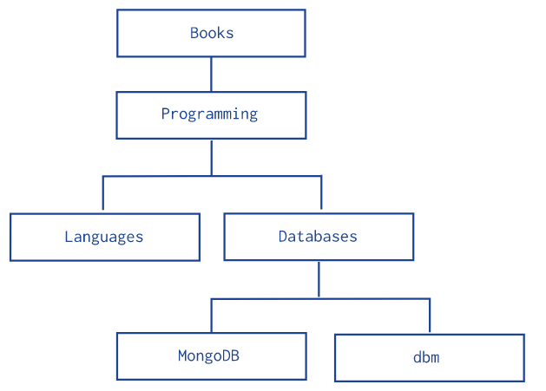
Model Tree Structures with an Array of Ancestors
This page describes a data model that describes a tree-like structure in MongoDB documents using references to parent nodes and an array that stores all ancestors.
The Array of Ancestors pattern stores each tree node in a document; in addition to the tree node, document stores in an array the id(s) of the node’s ancestors or path..
Hierarchy of Categories
The following example models the tree using Array of Ancestors. In addition to the ancestors field, these documents also store the reference to the immediate parent category in the parent field
db.categories.insertMany( [
{ _id: "MongoDB", ancestors: [ "Books", "Programming", "Databases" ], parent: "Databases" },
{ _id: "dbm", ancestors: [ "Books", "Programming", "Databases" ], parent: "Databases" },
{ _id: "Databases", ancestors: [ "Books", "Programming" ], parent: "Programming" },
{ _id: "Languages", ancestors: [ "Books", "Programming" ], parent: "Programming" },
{ _id: "Programming", ancestors: [ "Books" ], parent: "Books" },
{ _id: "Books", ancestors: [ ], parent: null }
] )

Slide 2
Model Tree Structures with an Array of Ancestors
The Array of Ancestors pattern provides a fast and efficient solution to find the descendants and the ancestors of a node by creating an index on the elements of the ancestors field. This makes Array of Ancestors a good choice for working with subtrees.
db.categories.findOne( { _id: "MongoDB" } ).ancestors
db.categories.createIndex( { ancestors: 1 } )
db.categories.find( { ancestors: "Programming" } )

Slide 3
Data Modelling in MongoDB
https://docs.mongodb.com/manual/tutorial/model-embedded-one-to-one-relationships-between-documents/

